Slide 1
Cyberbullying Detection
Using Support Vector Machine (SVM) Algorithm
A research-based project presented to you by:
F. Ballesteros | P.M. Capuz | S. Mallari | E. Samillano

Slide 2
Cyberbullying in the Philippines
a form of harassment that occurs via the Internet which includes vicious forum posts, name calling in chat rooms, creating fake profiles on social networking sites, and sending cruel messages
Notes:
- Place definitions of cyberbullying from different people (experts) and add the team’s own definition of it based from the gathered resources

Slide 3
Cyberbullying Laws in the Philippines
R.A. 10627 - Anti Bullying Act of 2013
House Bill 5718
Notes:
- Place definitions of cyberbullying from different people (experts) and add the team’s own definition of it based from the gathered resources

Slide 4
How do social media platforms deal with cyberbullying?
Privacy Settings
Reporting Tools
YouTube’s Safety Mode
Twitter’s Mute Feature
Notes:
- Place definitions of cyberbullying from different people (experts) and add the team’s own definition of it based from the gathered resources

Slide 5
STATEMENT OF THE PROBLEM
How can cyberbullying statements in Filipino be detected in social media sites?

Slide 6
OBJECTIVES
Main Objective
To create an application that can detect cyberbullying statements in Filipino in social media sites.

Slide 7
OBJECTIVES
Specific Objectives
To gather textual data for the corpus
To perform text preprocessing
To perform text annotation on the dataset
To implement machine learning algorithm using WEKA
To generate a cyberbullying detection model
To develop a cyberbullying detection system
To test system performance

Slide 8
SCOPE AND LIMITATIONS
Corpus: All 2000 statements were extracted from public, controversial posts in Twitter, Facebook, and YouTube
Text preprocessing methods: cleaning of the dataset, tokenization, and conversion of the data to Bag-of-words
Cleaning of the dataset: removing special characters, non-readable text, emoticons, links, and foreign language characters. Basic Jejemon slang was retained in the dataset.
The annotation schemes used are the following: cyberbullying, not cyberbullying, and ambiguous cyberbullying

Slide 9
SCOPE AND LIMITATIONS
The machine learning algorithm that was implemented is the Support Vector Machine (SVM) algorithm
10-fold Cross Validation was used for determining the accuracy and Kappa statistic (metrics) of the model. It yielded an accuracy rate of 57.95% and a Kappa Statistic of 20.94%
The cyberbullying detection model was designed to analyze and classify public posts that were written in Filipino

Slide 10
SCOPE AND LIMITATIONS
The application was programmed using Java
It will come in the form of a website extension or plug-in
Twitter was selected as the application’s testing ground
Twitter4J was the tool used to interact with Twitter API

Slide 11
SCOPE AND LIMITATIONS
Only flagged cyberbullying statements will be reported
Access to the application is limited to social media administrators only
Reports will be arranged in tabular format
Procedures to be implemented by the authorities to resolve the issue is no longer covered in the project

Slide 12
SCOPE AND LIMITATIONS
Detection will be done word per word
The report will contain the post, its annotation, the user who posted it, and the time and date it was posted

Slide 13
SIGNIFICANCE
To social media moderators
To Filipino social media users
To the researchers
To anti-cyberbullying advocates

Slide 14
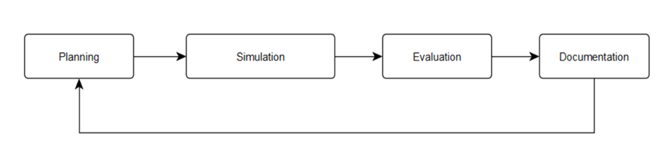
SOFTWARE DEVELOPMENT LIFE CYCLE
Notes:
- Place definitions of cyberbullying from different people (experts) and add the team’s own definition of it based from the gathered resources

Slide 15
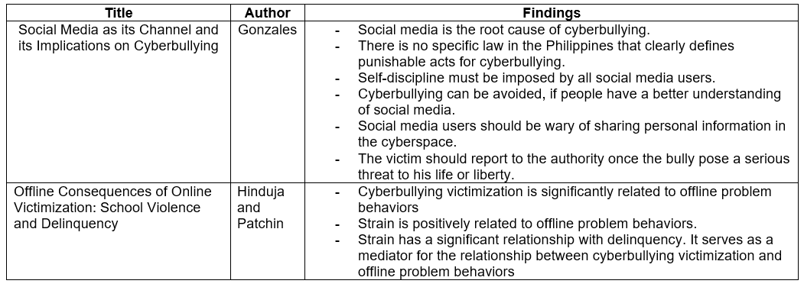
REVIEW OF RELATED LITERATURE

Slide 16
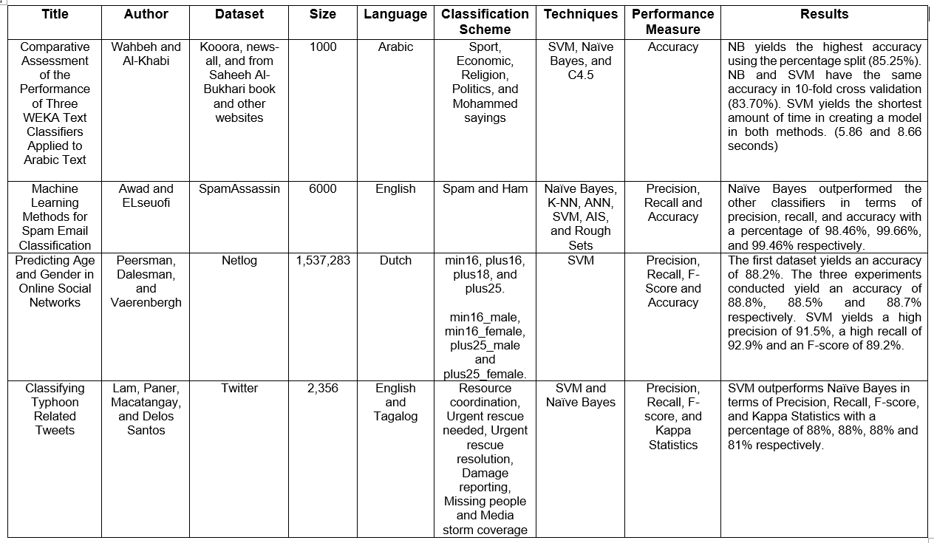

Slide 17
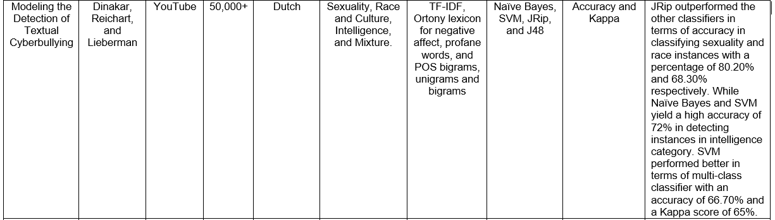

Slide 18
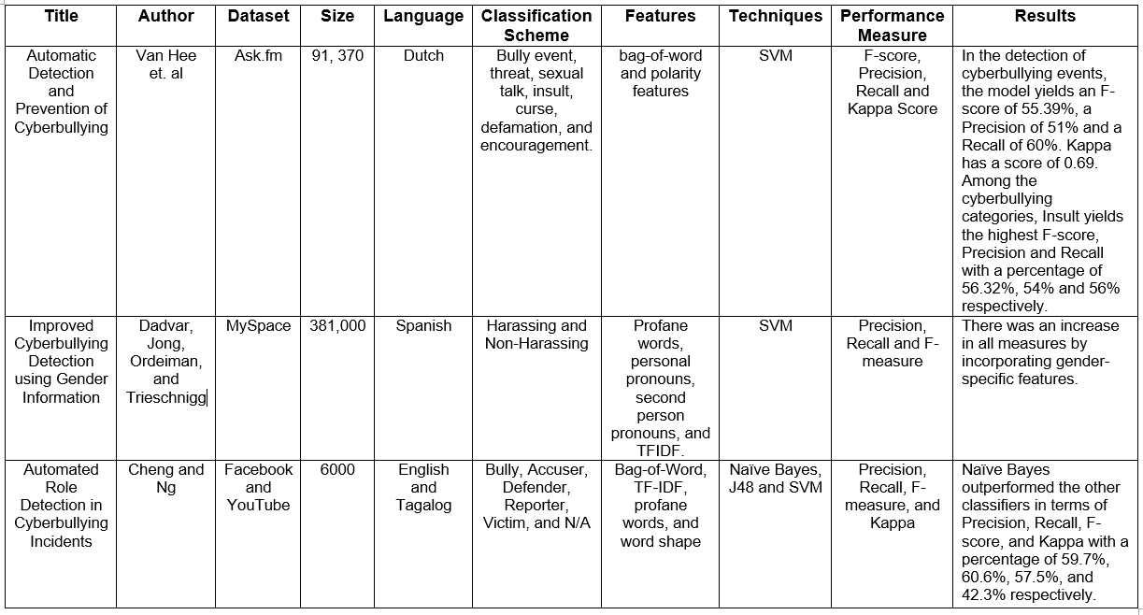

Slide 19
- Cyberbullying Detection using Time Series
Modeling by Potha and Maragoudakis
- An Effective Approach for Cyberbullying Detection
by Nahar, Li, and Pang

Slide 20
Cyberbullying Detection using Time Series
Modeling by Potha and Maragoudakis

Slide 21
THEORETICAL BACKGROUND
Audience Segregation
Introduced by Ervin Goffman
It describes how people play different roles in different situations.
It is a mechanism wherein an individual perform roles, in order to create a favorable image of themselves and leave a good impression to others that is linked to the role they perform.
The role that the individual performs is based on who their audience is.

Slide 22
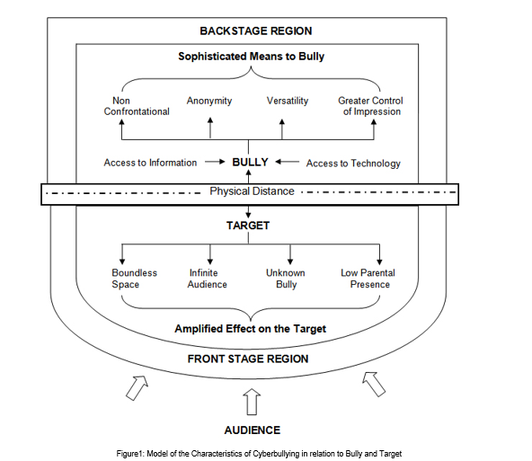
Audience Segregation by Ervin Goffman

Slide 23
Theoretical Background
Text Classification
Classifies document into predefined categories
The document can either be found in a single, multiple, or no category.
With the aid of Machine Learning, the process of text classification can be automated

Slide 24
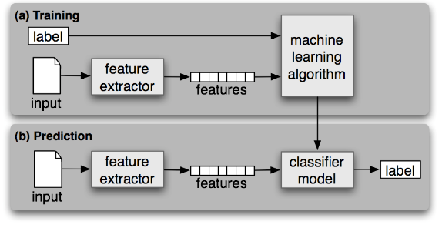
Statistical Text Classification

Slide 25
THEORETICAL BACKGROUND
Support Vector Machine
One of the most commonly used linear model
SVM performs classification by creating a k-dimensional hyperplane that separates the data into two categories.
It is a non-probabilistic binary linear classifier

Slide 26
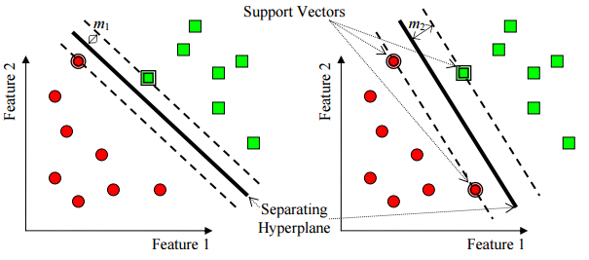
Support Vector Machine (SVM)

Slide 27

THEORETICAL BACKGROUND
Naïve Bayes
Naive Bayes is a group of classification algorithms based on Bayes Theorem. This family of algorithms shares a common principle that every feature is independent of the value of other features regardless of any correlations between them. It assumes that these features independently contribute to the probability that an item belongs to a certain class. Naïve Bayes predicts a class, given a set of features using probability. The principle behind Naïve Bayes rule is that the outcome of a hypothesis (H) can be predicted through the use of some evidences (E) that can be observed from the rule.
$P(E)=[P(H)∗P(H)]/P(E)$

Slide 28
THEORETICAL BACKGROUND
J48
J48 is a simple C4.5 decision tree used for classification. It constructs a binary tree. This decision tree approach is deemed useful in dealing with classification problems. The tree will model the process of classifying data. It builds decision trees from a set of labeled training data through information entropy. Moreover, it assumes that each attribute can be used to make a decision by dividing the data into smaller subsets.

Slide 29
THEORETICAL BACKGROUND
Decision Stump
Decision Stump is a machine learning model composed of a one-level decision tree. The tree has one internal node (the root) that is linked to the terminal nodes (its leaves). This model is also called 1-rules because it predicts based on the value of a single input feature (Holte, 1993).

Slide 30
THEORETICAL BACKGROUND
Random Forest
Random Forest is a collection of simple tree predictors wherein each predictor can produce a response once presented with a set of predictor values. In classification problems, this response may come in a form of a class membership which classifies a set of independent predictor values with one of the categories that are present in the dependent variable. Given a set of simple trees and a set of random predictor variables, it will define a margin function that measures the extent to which the average number of votes for the correct class exceeds the average vote on any other class which are present in the dependent variable.

Slide 31
THEORETICAL BACKGROUND
REPTree
The Reduced Error Pruning Tree or REPTree is a fast decision tree learner. The goal is to construct a decision tree using information gain and prune it using reduced-error pruning. It utilizes the logic of regression tree and constructs several trees in different iterations then it will select the best among all the trees which will be labelled as the representative. In pruning the tree the measure used is the mean square error on the predictions made by the tree.

Slide 32
THEORETICAL BACKGROUND
Hoeffding Tree
Hoeffding Tree was derived from the Hoeffding bound that is used in the tree induction. The main idea behind this algorithm is Hoeffding bound gives certain level of confidence on the best attribute to split the tree. Thus, a model can be built based on certain number instances known.

Slide 33
THEORETICAL BACKGROUND
Decision Table
The Decision Table algorithm summarizes the dataset by using a decision table which is composed of the same number of attributes as the original dataset.
A new data item is assigned a category by finding the line in the decision table that matches the non-class values of the data item.
It employs the wrapper method in order to find a good subset of attributes that will be included in the table.

Slide 34
THEORETICAL BACKGROUND
JRip
Jrip (RIPPER) is one of the most simple and popular Machine Learning algorithm. In this algorithm, classes are examined in increasing size and an initial set of rules for the class is constructed through incremental reduced error.

Slide 35
THEORETICAL BACKGROUND
OneR
It is a simple classification algorithm that is based on one attribute only and it produces a one-level decision tree. It generates one rule for each attribute and selects the rule that will yield the least error rate. However, if there are two or more rules that have the same least error rate, the rule will be selected randomly (Zhao & Zhang, 2007).
Rules are created by identifying the most often class

Slide 36
THEORETICAL BACKGROUND
Bag of Words (BoW) Model
The goal is to create a numeric representation for the data.
It is defined as an order less document representation
A word in a document is assigned a weight according to its frequency in the document and frequency in between different documents.

Slide 37
THEORETICAL BACKGROUND
Performance Measures
Most evaluation for the text classifier is conducted experimentally
It is used to measure its effectiveness or the quality of its predictions on the classification of data

Slide 38
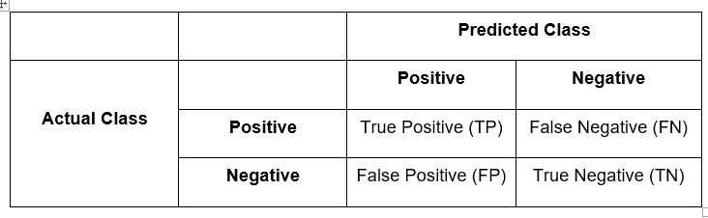
Confusion Matrix

Slide 39

THEORETICAL BACKGROUND
Precision
Precision is used to measure the exactness of the classifier
It is also called positive predictive value (PPV)

Slide 40

THEORETICAL BACKGROUND
Recall
It is used to measure the completeness of a classifier.
Moreover, it is also called the true positive rate or sensitivity.

Slide 41

THEORETICAL BACKGROUND
Accuracy
The accuracy is the percentage of instances that were correctly classified into their respective classes.
It is also called sample accuracy.
It may yield to misleading result if the dataset is unbalanced

Slide 42

THEORETICAL BACKGROUND
F-Measure
The F-measure (or F-score) is used to measure the accuracy of the test by considering both precision and recall in computing the score.

Slide 43

THEORETICAL BACKGROUND
Kappa Statistics
The calculation is based on the difference between the numbers of agreement that are actually present compared to the numbers of agreement that would be expected to be present by chance.

Slide 44

SYSTEM APPLICATION

Slide 45
OBJECTIVES
Automatically detect cyberbullying statements in the site
Flag detected cyberbullying occurrences
Produce timely and organized reports that can only be accessed by authorized personnel

Slide 46



DESIGN AND METHODOLOGY
Software Applications Used

Slide 47
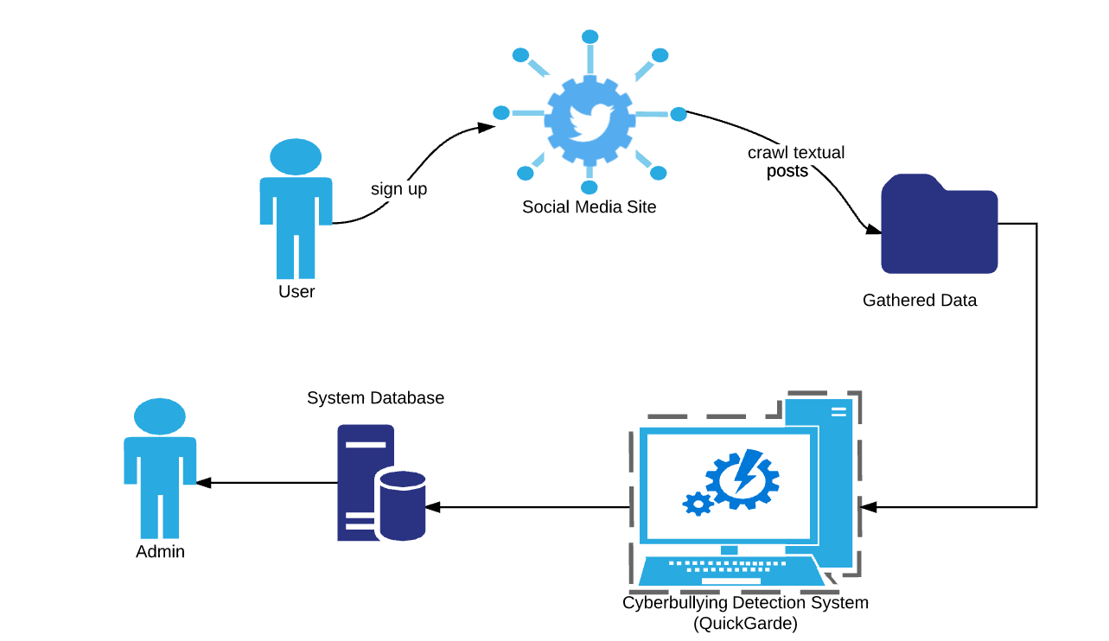
SYSTEM ARCHITECTURE

Slide 48
SYSTEM ARCHITECTURE

Slide 49
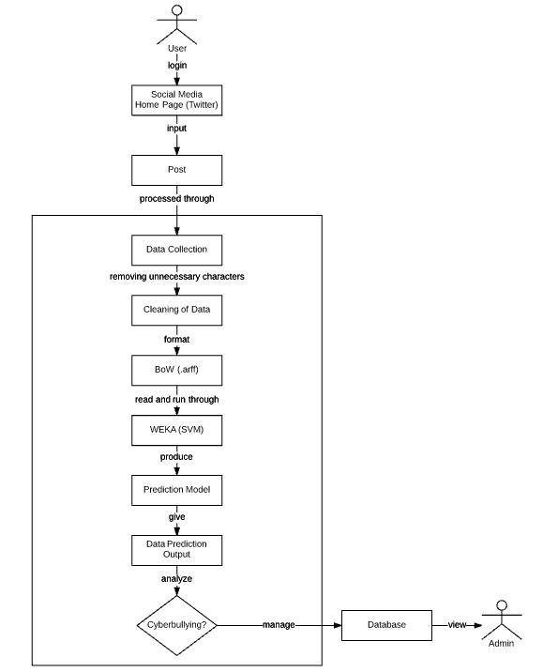

Slide 50
SYSTEM ARCHITECTURE PHASES
Data Collection
Cleaning of the dataset
Data Annotation
Tokenization
Bag of Words
Support Vector Machine
Cyberbullying Detection Model

Slide 51
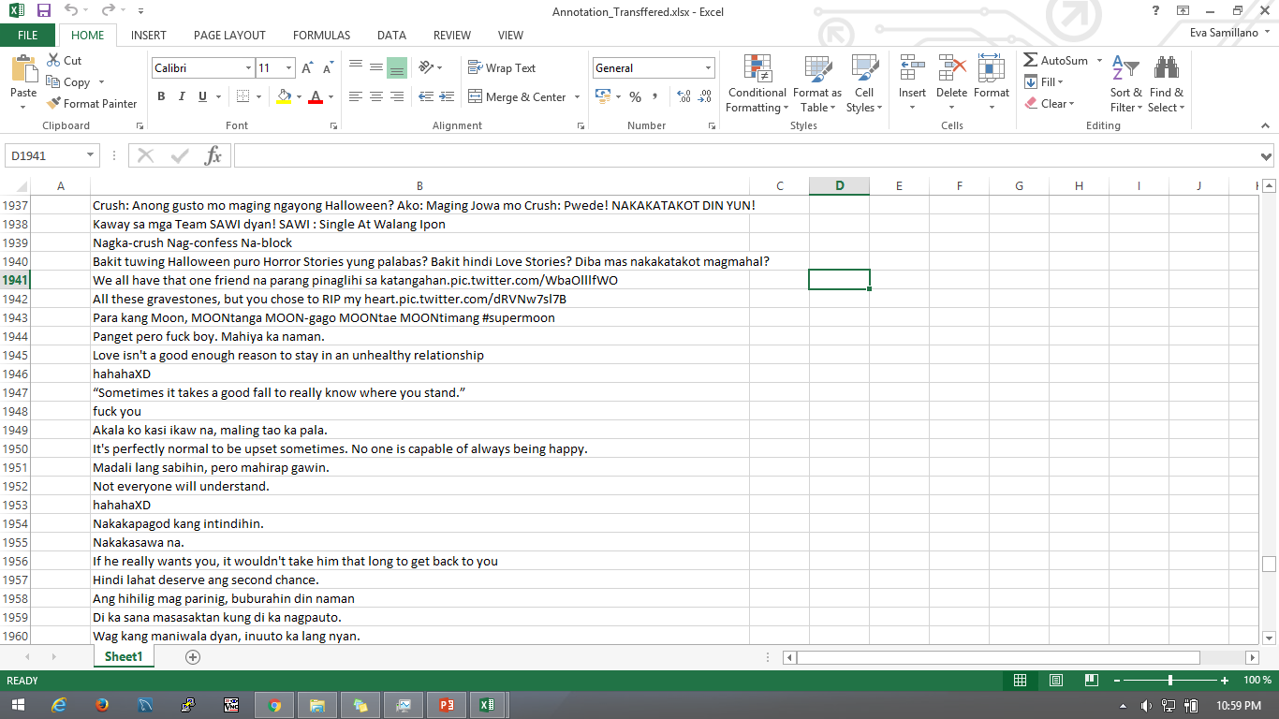
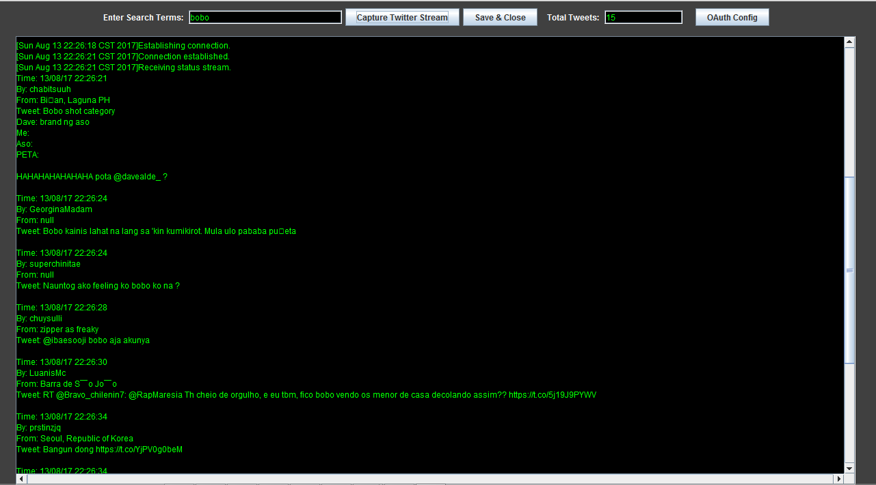
Data Collection
2000 Data | Import.io | Controversial Issue

Slide 52
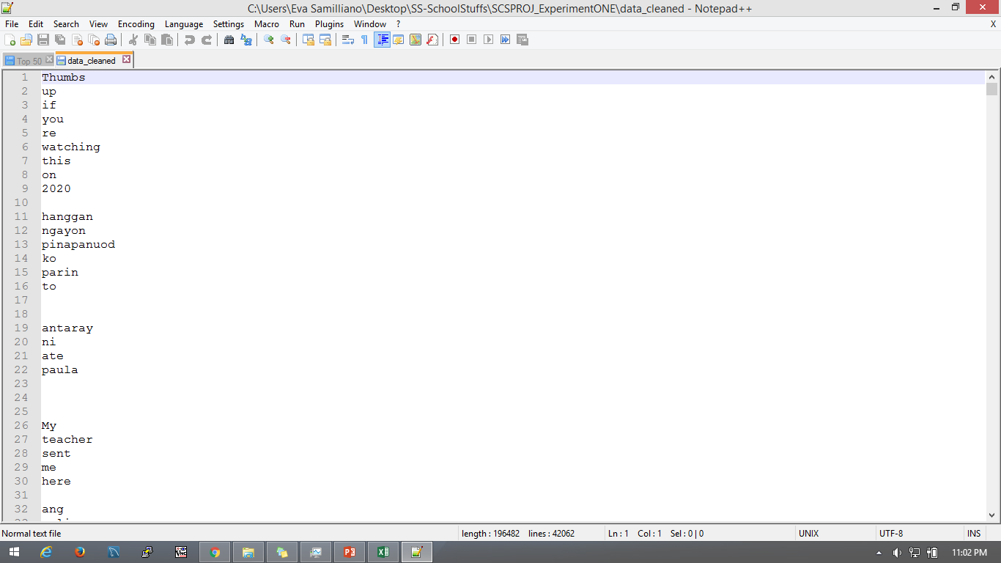
Cleaning of Dataset
!@#$%^&*()-_=+:”;’{}|[]\<>?,./| and not Filipino Language and Links

Slide 53
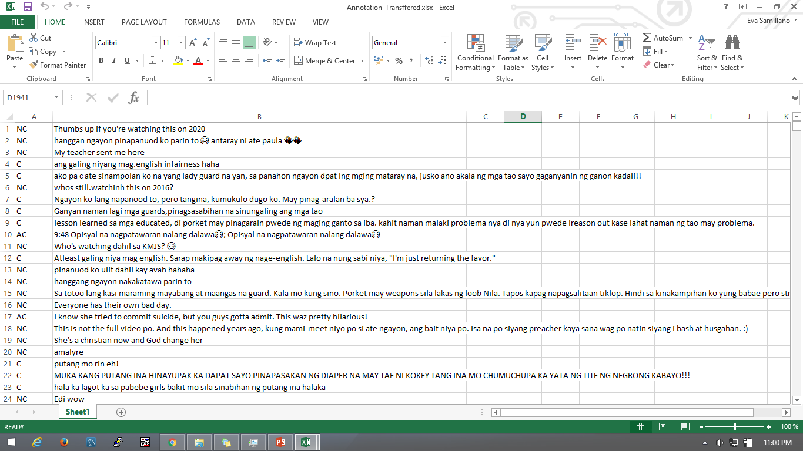
Data Annotation
1=10 Statement/1000 Data | 1000 Data - Researchers

Slide 54
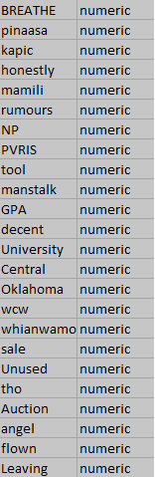
Tokenization
Total of 7062 out of 2000Data

Slide 55
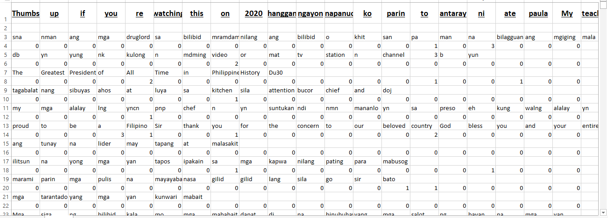
Bag of Words

Slide 56
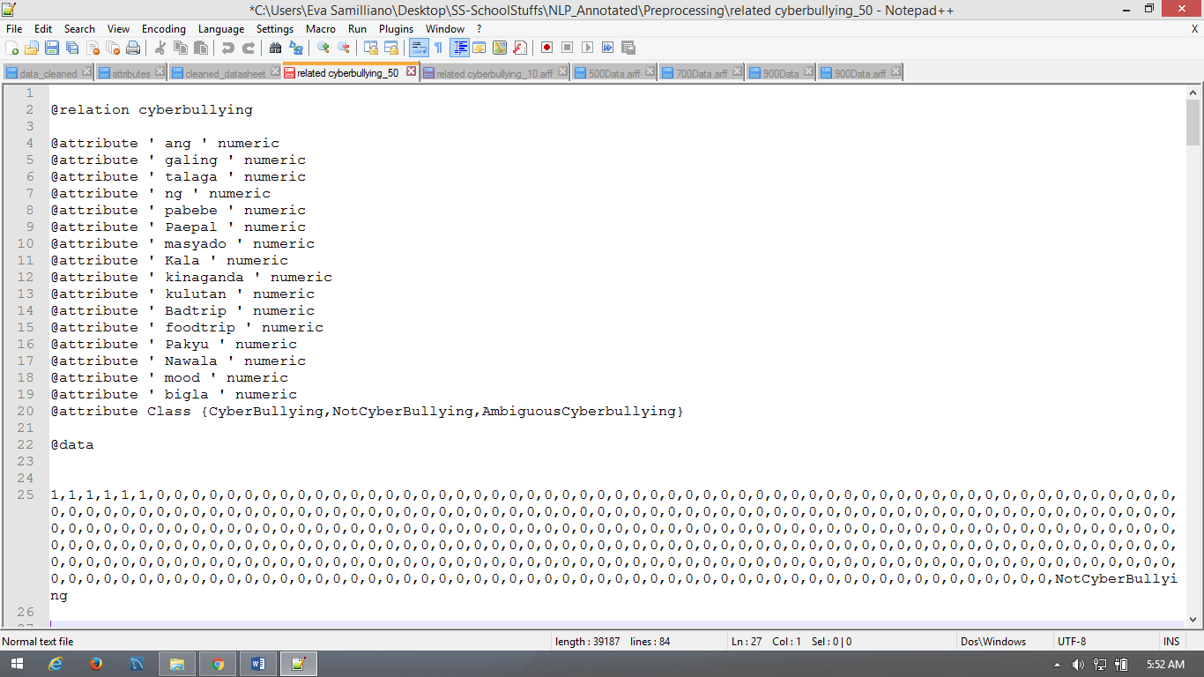
Support Vector Machine

Slide 57
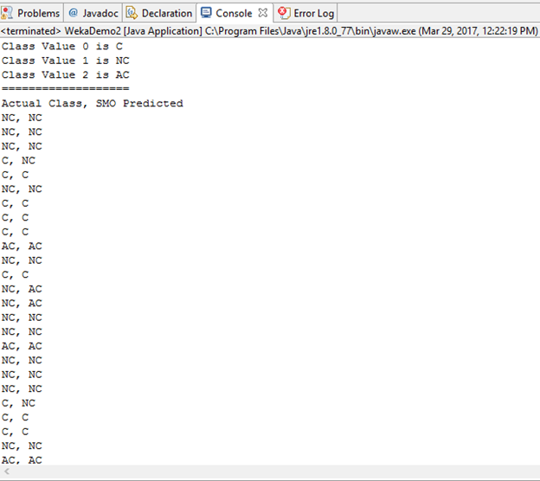
Cyberbullying Detection Output

Slide 58
RESULTS AND DISCUSSION
DATA ANALYSIS

Slide 59
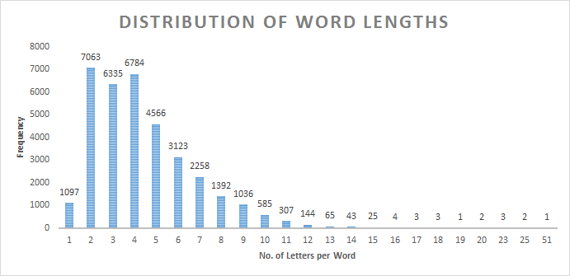
Data Analysis – Length of words per statement

Slide 60
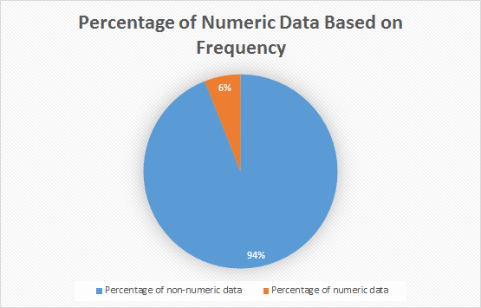
Data Analysis – Presence of numeric Data

Slide 61
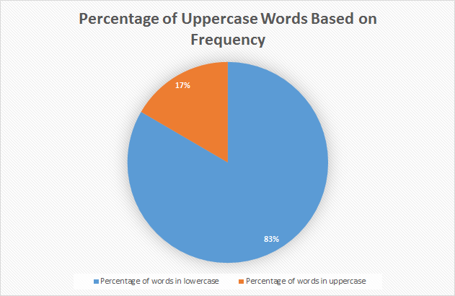
Data Analysis – Presence of words in UpperCase

Slide 62
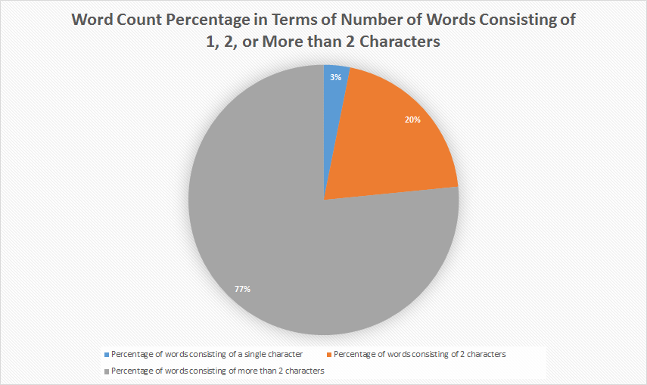
Data Analysis – Presence of words consisting of single or double characters

Slide 63
Data Analysis – Top 50 Cyberbullying Keywords
Rank | Word(s) | No. of occurrences
1 | INA/unu | 566
2 | TANG/tung | 210
3 | puta/putang/pota/PUTANGINA/pokeng | 155
4 | Hahahaha/Hihi/Hehehe | 153
5 | baba | 137
6 | gay | 122
7 | fuck/fucking/FUCKIN/pakyu | 97
8 | HAYOP/KABAYO/ANIMAL/daga/pet/baboy | 95
9 | mamatay/hell/Kill/patay/bitayin | 93
10 | LANDI/itch | 88
11 | gang | 70
12 | pusher/druglord/lord/drug | 70
13 | tawa/Kakatawa | 69
14 | BIG | 64
15 | gago/tado | 62
16 | King | 61
17 | tanga/ulol/ulul | 52

Slide 64
Data Analysis – Top 50 Cyberbullying Keywords
18 | gaga | 47
19 | malandi/Kalandi/baliw/abnoy | 45
20 | loko | 42
21 | bakla/Kadiri | 41
22 | ass/Butt | 39
23 | che | 37
24 | mahina/matanda/slow | 37
25 | hiya | 35
26 | bitch/tarantado | 35
27 | bobo/stupid/kupal | 33
28 | bad | 30
29 | paa/TAE | 29
30 | panga | 26
31 | wawa/Kaawa | 26
32 | baho/kati | 25
33 | punyeta/shit/bwiset/Bullshit | 24
34 | tangina | 23
35 | yaya | 23

Slide 65
Data Analysis – Top 50 Cyberbullying Keywords
36 | adik/salot | 22
37 | mahirap | 21
38 | pabebe/epal | 21
39 | malaki | 17
40 | pangit | 17
41 | BLACK/FAT/Blind/sunog | 17
42 | Bayag/pepe/etits/tuwad/pakantot /boobs/penis | 17
43 | Kapal | 15
44 | Yuck/Ewww | 8
45 | HYPOCRITE/pathetic | 6
46 | bruha/halimaw | 6
47 | demonyo | 4
48 | yawa | 4
49 | engot | 3
50 | inarte | 1

Slide 66
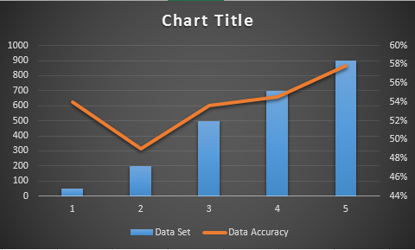
Data Analysis – Adding more data in the dataset

Slide 67
Data Analysis – Percentage Split
Training Data (%) | Testing Data (%) | Accuracy | Kappa Statistics
60 | 40 | 45.8824 | 0.0911
70 | 30 | 47.3333 | 0.114
80 | 20 | 55 | 0.2177
90 | 10 | 50 | 0.1325

Slide 68
Data Analysis – K-Fold Cross Validation
K-Fold | Accuracy | Kappa Statistics
2 | 57.65 | 0.1933
3 | 57.65 | 0.2007
4 | 58.2 | 0.2082
6 | 58.05 | 0.2096
7 | 58.15 | 0.2081
8 | 58.85 | 0.2288
9 | 56.95 | 0.2084
10 | 57.95 | 0.2094

Slide 69
Data Analysis – Using Different Algorithms
Algorithm | Accuracy | Kappa Statistics | Time (seconds)
SVM | 57 | 0.2094 | 47.56
Naïve Bayes | 45.8 | 0.1272 | 4.98
J48 | 53.7 | 0.1619 | 61.84
ZeroR | 56.9 | 0 | 0.02
Decision Stump | 56.9 | 0 | 2.78
RandomTree | 48.55 | 0.1008 | 2.97
RandomForest | 61 | 0.1712 | 40.25
RepTREE | 56.9 | 0.1026 | 14.04
HoeffdingTree | 56.9 | 0 | 17.19
DesicionTable | 58.8 | 0.1173 | 628.02
JRip | 57.9 | 0.0594 | 48.21
OneR | 55 | 0.0431 | 1.45

Slide 70
Data Analysis
Unigram VS Trigram
Frequency VS TF-IDF

Slide 71
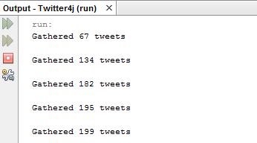
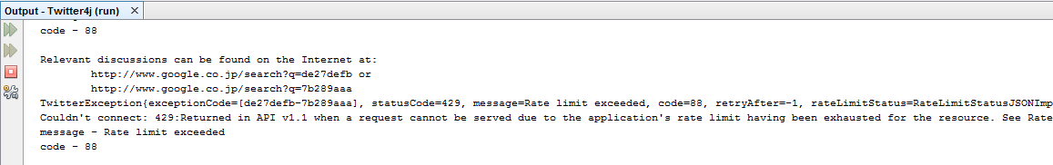
OUTPUTS

Slide 72
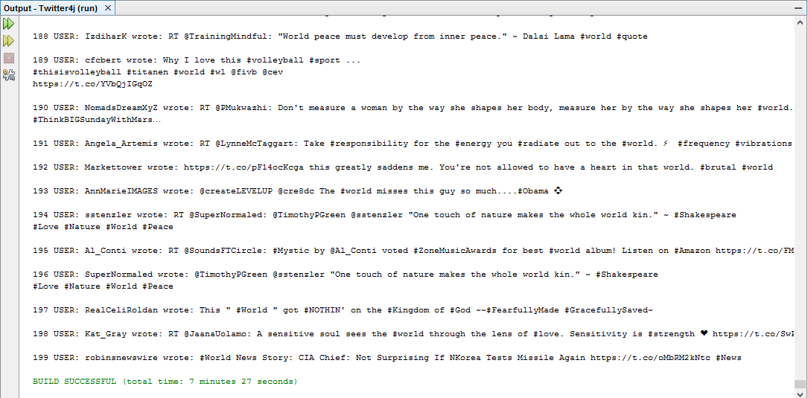
OUTPUTS

Slide 73
OUTPUTS

